Slide 1






Senior Design Project:
Cognitive Assistance with LiDAR
Localization (C-ALL)
Project Release
Ahmad Shah, Neeti Mistry, Sara Gaber & Sohan Chatterjee
Notes:
TUESDAY April 29
Ahmad: 12-13, 15-21
Neeti: 1-7
Sara: 14, 22-26
Sohan: 8-11

Slide 2



Overview
Brief Overview and Summary of Project

Slide 3

Overview
Objective: Develop an affordable, real-time navigation system for visually impaired individuals
Utilizing LiDAR technology integrated into newer iPhone Pro 12+ models for real-time navigation
Technology Stack: LiDAR, Swift, Geographical ARKit, Bluetooth, Raspberry Pi, Mobile Application (iOS), SolidWorks
Who is this app for?
Visually impaired individuals looking for a more independent mobility aid
Why does it matter?
Impact: Enhancing mobility, independence, and accessibility
Supports users in daily tasks without depending on others
Notes:
Add more elevator pitch details here

Slide 4
Team Logo
Developed Team Logos

Slide 5

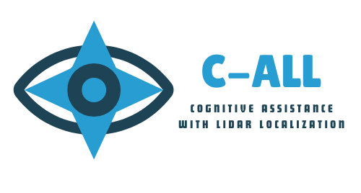

Team Logo

Slide 6
Poster
Final Innovation EXPO Poster

Slide 7
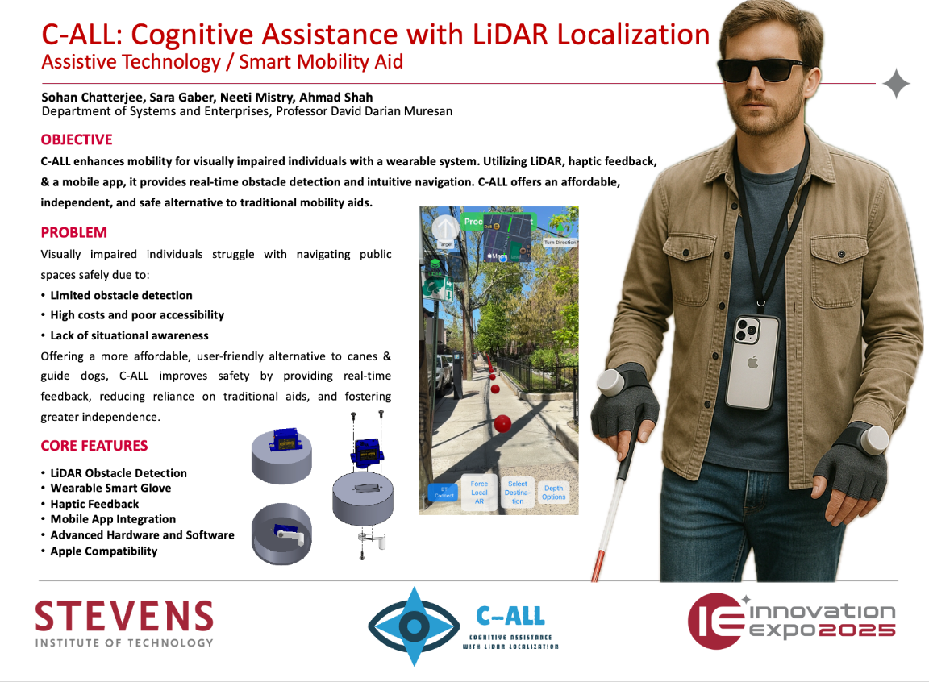

Slide 8
Key Features
Project Implementation

Slide 9
Key Features
Key Features
Real-time obstacle detection and path guidance
Integration between hardware and software
Mapping and navigation on sidewalks rather than roads for improved pedestrian safety
Works in both day and night
Bluetooth pairing with wearable hardware gloves on each hand
Accessible UI and voice control

Slide 10
Live Demo Outline
Demo Structure

Slide 11
Live Demo Outline
Overview of Demo Structure
App Launch and Navigation
Navigation Setup and Hardware Pairing
Obstacle Detection in Action
Day and Night Usage
Emergency Feature Preview

Slide 12
Demo – App Launch and Navigation
Launching the App

Slide 13
App Launch and Navigation
Purpose: Demonstrate starting the app and accessing key navigation features
Launch the C-ALL app on iPhone
Home Screen: Clean, accessible UI with large buttons and voice-over support
UI accessibility options (e.g., voice settings, large fonts)
Show user location and environment map
Option to start navigation or pair device

Slide 14
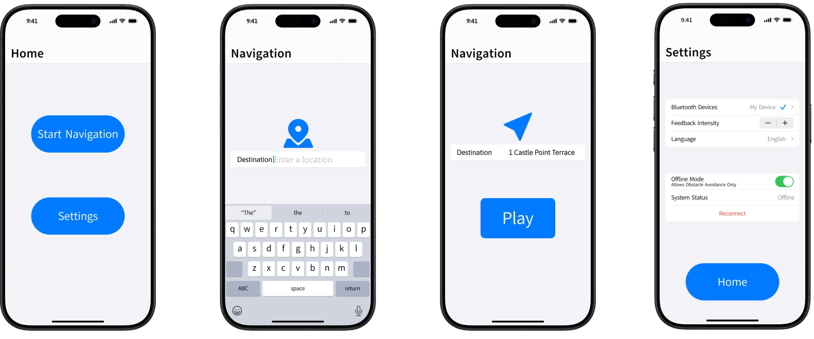
UI Prototype

Slide 15
Demo – Navigation Setup and Hardware Pairing
Setup Process and Pairing with Bluetooth

Slide 16
Navigation Setup and Hardware Pairing
Purpose: Highlight how easy it is to connect and begin using the system
Bluetooth pairs with both gloves
Real-time sync with app for left/right haptic feedback
Showcase glove interaction (vibration when direction changes)
Walkthrough of user setting destination via voice or touch

Slide 17
Demo – Obstacle Detection in Action
Obstacle Detection and Navigation Process

Slide 18
Obstacle Detection in Action
Purpose: Show the core feature, LiDAR-powered obstacle detection
Simulate approaching static and dynamic obstacles (e.g., chair, moving person)
Show how gloves work based on obstacle proximity (intensity/direction)
Overlay map updates as user reroutes or avoids collisions
LiDAR recognizes elevation and surface changes (e.g., curb)

Slide 19
Demo – Day and Night Usage
Can Be Used in Night Conditions As Well

Slide 20
Day and Night Usage
Purpose: Prove the system works in all lighting conditions
Day Mode: Show detection and navigation outdoors
Switch to low light or dark environment
Show how LiDAR continues to detect objects accurately
Emphasize LiDAR independence from visible light

Slide 21
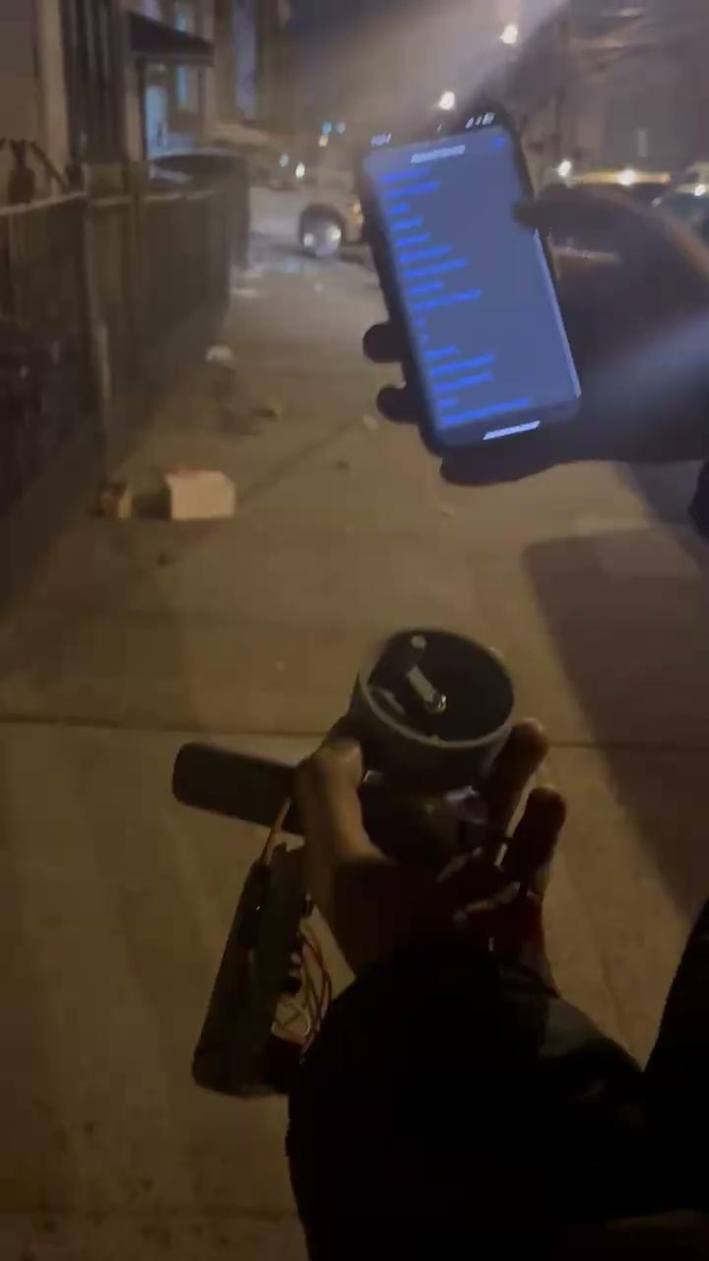
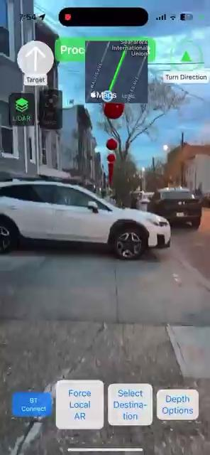
Day and Night Usage

Slide 22
Emergency Feature Preview
Emergency Location Sharing Feature

Slide 23
Emergency Feature Preview
Purpose: Introduce safety-oriented upcoming feature that enhance independence
Share location with emergency contacts via one voice command
Auto-text to emergency contact with live location
Designed with safety and autonomy in mind

Slide 24
What’s Next for C-ALL?
Future Iterations and Improvements

Slide 25
What’s Next for C-ALL?
Publish C-ALL app on the App Store for wider accessibility
Implement emergency location sharing feature to enhance user safety
Continue gathering user feedback to refine features and improve usability for software updates
Partner with accessibility and mobility organizations for outreach and collaboration
Explore multilingual support to reach more users globally
As an early-stage product, durability and weather resistance can be improved in future iterations.

Slide 26





Thank you!
Any Questions?

